Slide 1

Year Five
Welcome meeting
2023-2024

Slide 2
Daily routines
School gate is open from 8:45 to 8:55
Children will have a rota of responsibilities to carry out within the classroom each day.
Guided reading when children arrive.
Break time at 10:30
Lunch time at 12:00
End of day: all children will now leave school at 3:30pm except for those on the bus.

Slide 3
Attendance
It is vital that children arrive at school ready to learn at 9am every morning.
It is disruptive to their learning and others in the class if they are late.
All of our subjects are taught in sequences of learning and missing ay part of the carefully structured sequence could lead to gaps in their understanding.

Slide 4
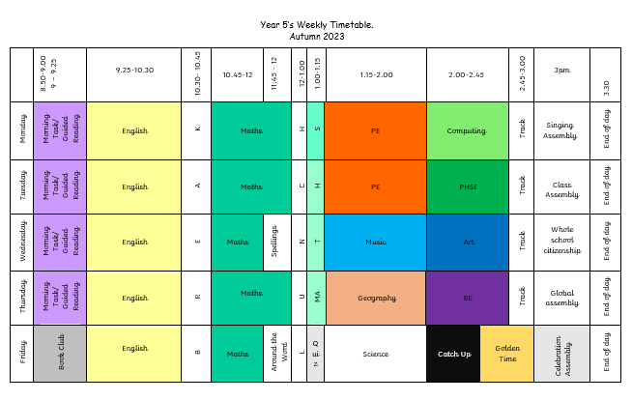

Slide 5
PE
The children will have PE on Monday and Tuesday afternoons.
Please can they wear full PE kit on these days: navy blue or plain black hoodie/sweatshirt, plain navy or black shorts/joggers, a plain white t-shirt and black trainers.
PE hoodies are only to be worn on these PE days as not as part of our full school uniform.
We endeavour to use the track daily at 2:45pm.

Slide 6
Cooperative Learning
The children will be experiencing their learning in groups of four with one team of six.
These groups are carefully considered and will be the same for an entire half term. This means that they will be part of seven ‘teams’ during this year.
One of the ideas behind this strategy is to teach children to collaborate, negotiate and succeed whilst working with any of their classmates.
Due to the nature of cooperative learning, these relationships can take time to establish and, as a school, we do not change these groups.
We often find that the most effective collaborative partnerships occur when children are not in the same social circles!
With reference to children’s relationships, it is normal for children to fall out with their peers – and then to make up. This is an essential part of growing up and being part of a community.

Slide 7
Home learning
Spelling
Weekly spellings will be tested every Wednesday and will be sent home via email.
Reading
The expectation is that Year 5 children are reading at least five times a week.
Times tables
Every Friday, the class will take part in the Around the World challenge.

Slide 8

Times tables rock stars
Times tables will be updated along with the Around the World challenge.
Opportunities for children to challenge each other – the aim is to promote enjoyment for learning times tables.

Slide 9
Celebrating learning
We will continue to use Dojo points and have agreed on the skills that we can achieve as a reward.
Every 1,000 we reach will result in a class treat.
On Friday afternoons, certificates are awarded for learning, kindness, excellent errors and other reasons across the school.

Slide 10
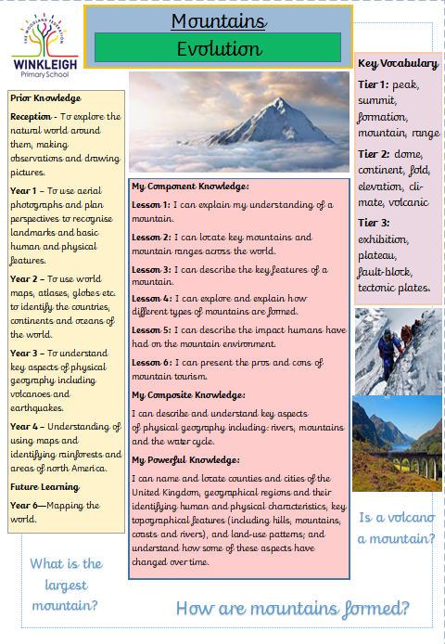
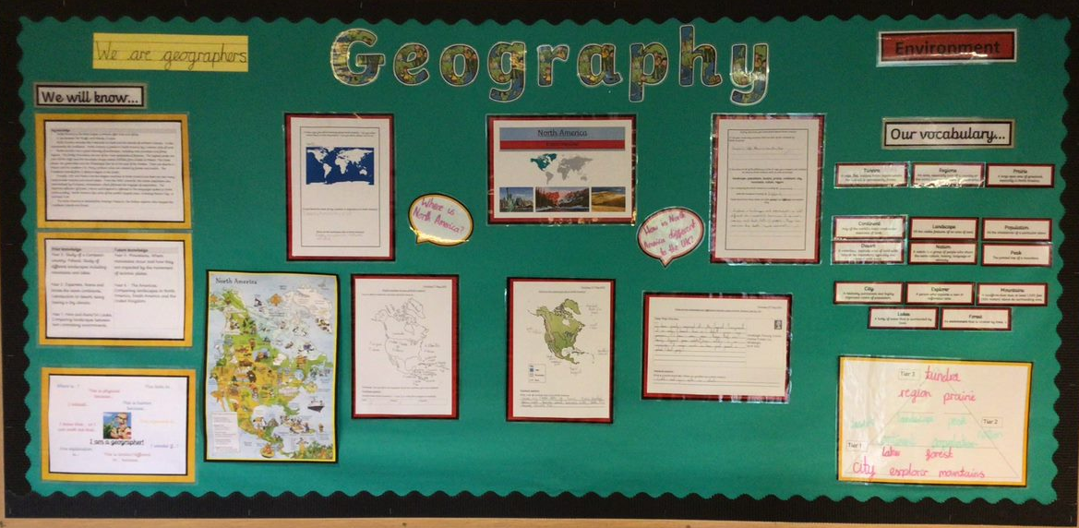
Displays and cover sheets
The Woodland Federation - Year 5

Slide 11
Curriculum map
 | Autumn 1 | Autumn 2 | Spring 1 | Spring 2 | Summer 1 | Summer 2
Maths | Place Value 3 weeks Construction | Multiplication & Division 3 weeks Conflict | Multiplication & Division 3 weeks Conflict | Perimeter and Area 2 weeks Construction | Shape 3 weeks Environment | Measures and Data 2 weeks Construction
 | Addition and Subtraction 3 weeks Evolution | Fractions 3 weeks Innovation | Fractions, Decimals and Percentages 3 weeks Innovation | Statistics 2 weeks Civilisation | Decimals 2 weeks Innovation | Converting Units 2 weeks Evolution
 |  |  |  | Position and Direction 2 weeks Construction | Negative Numbers 2 weeks Evolution | Volume 2 weeks Environment
English | Inspirational People – 2 weeks Legacy | Kensuke’s Kingdom 6 weeks Legacy | The Lost Words - 3 weeks poetry Environment | Recount Reports 3 weeks Construction | The tear thief 3 weeks Environment | Paraphernalia 3 weeks Civilisation
 | Great Adventurers - 2 weeks non-fiction Evolution |  | Short Stories – 3 weeks Conflict | Varjak Paw 3-4 weeks Civilisation | Argument and Debate 3 weeks Conflict | Explanation and instruction: Stuff you should know! 3 weeks Innovation
 | The Dictionary of Difficult Words - 2 weeks Innovation | Eats, Shoots and Leaves- 1 week Construction
Science | Properties of materials Innovation |  | Animals including humans Evolution | Living things and their habitats Evolution | Earth and Space Conflict | Forces Innovation
Geography/ History | Mountains Evolution | Victorians Legacy | Water and the water cycle Environment | Vikings Conflict | Sustainable Living Environment | WWII Innovation
Art/ DT | Collage Construction |  | Painting & Drawing Environment |  | Sculpture Construction
RE | What does it mean if Christians believe God is holy and loving? Legacy | Muslims in Britain today? Civilisation | What would Jesus do? Evolution | Jesus the messiah Civilisation | Torah scroll importance Legacy | Humanists Evolution
PSHE | Me and my relationships Conflict | Valuing difference Evolution | Keeping safe Innovation | Rights & Respect Environment | Being my best Construction | Changing and growing Innovation
Music/ Spanish | How does music bring us together? Innovation |  | Playing tuned and untuned instruments Innovation |  | Introducing chords: How does music teach us about our community? Legacy
Computing | sharing information Evolution | vector drawing Innovation | Data and information Construction | Programming A – Construction | Selection in quizzes Innovation | Variables in games Construction

Slide 12
Trips
Autumn term
28th September – Ultimate Adventure with Year 6
10th November – Remembrance Church visit
22nd November - Morwellham Quay
Spring term
10th January – South West Water Visit
14th March – Stover National Park
Summer term
15-17th April – Skern Lodge
16th May – Exeter Synagogue & Mosque
Upotterry Airfield (TBC)
As well as these trips, we look forward to being invited to some sports activities and fixtures throughout the year alongside various days within school.

Slide 13
Communication
If you have any questions about anything regarding your child, please do not hesitate to contact myself as the class teacher.
Please email admin@winkleigh.devon.sch.uk .We will always try to get a reply to you within 48 hours.
As a school, we take allegations of bullying very seriously. Should you have a concern regarding this, speak to me straight away and a full investigation will be carried out.

Slide 14
Online Safety
After reading the government’s most recent Keeping Children Safe in Education document, alongside our training and experiences nationally,, we would ask you to be extra vigilant with your children’s online activities at home.
We have received extra guidance regarding how we filter and monitor children’s internet usage whilst in school from the government.
Online safety will continue to be taught as part of the ICT curriculum each term.

Slide 15
Any questions?

